Slide 1








Slide |
1
2
Payroll Management
System
Automating Payroll Generation
&
Backend Interaction
GROUP-6
Objective:
To create a secure and efficient system for managing employee payroll using MySQL and Node.js.
Relevance:
Payroll systems are vital for ensuring accurate salary calculations, tax compliance, and employee satisfaction, while also improving operational efficiency and scalability.

Slide 2



1
Payroll Management
System
Automating Payroll Generation
&
Backend Interaction
Slide |
2
3
Objective:
Overview:
To create a secure and efficient system for managing employee payroll using MySQL and Node.js.
An automated Payroll Management System for salary calculations, tax deductions, and record-keeping, ensuring timely and accurate payments with detailed payroll records.
Relevance:
Required Knowledge:
Payroll systems are vital for ensuring accurate salary calculations, tax compliance, and employee satisfaction, while also improving operational efficiency and scalability.
Node.js: For backend development.
SQL/Database: For managing payroll data.
Authentication & Security: For handling sensitive information.

Slide 3


Common Practice:
2
Traditionally, payroll systems were often managed using simpler tools like Excel sheets or CSV files. These methods involve manually entering employee data (such as salary, tax deductions) into rows and columns, often without any automation or real-time calculations. Payroll departments would rely on spreadsheet formulas or manual data entry to perform calculations and generate reports, making this process more labor-intensive.
Limitations:
Scalability:
Hard to manage as employee numbers grow, leading to slower processes and errors.
Data Integrity:
Manual entry increases the risk of mistakes and inconsistencies.
Real-Time Updates:
No automation or integration, requiring manual updates for changes like salary adjustments.
Slide |
3
4
Objective:
Overview:
To create a secure and efficient system for managing employee payroll using MySQL and Node.js.
An automated Payroll Management System for salary calculations, tax deductions, and record-keeping, ensuring timely and accurate payments with detailed payroll records.
Relevance:
Required Knowledge:
Payroll systems are vital for ensuring accurate salary calculations, tax compliance, and employee satisfaction, while also improving operational efficiency and scalability.
Node.js: For backend development.
SQL/Database: For managing payroll data.
Authentication & Security: For handling sensitive information.

Slide 4


3
Slide |
4
5
Common Practice:
Analysis of Limitation:
Traditionally, payroll systems were often managed using simpler tools like Excel sheets or CSV files. These methods involve manually entering employee data (such as salary, tax deductions) into rows and columns, often without any automation or real-time calculations. Payroll departments would rely on spreadsheet formulas or manual data entry to perform calculations and generate reports, making this process more labor-intensive.
Traditional payroll methods are prone to human error, such as mistakes in tax calculations or incorrect employee records.
These methods are not scalable - as businesses grow, managing payroll manually becomes more difficult.
Tax deductions and employee records can easily be mismanaged, leading to compliance issues.
Limitations:
Need for Innovation:
Scalability:
Hard to manage as employee numbers grow, leading to slower processes and errors.
Data Integrity:
Manual entry increases the risk of mistakes and inconsistencies.
Real-Time Updates:
No automation or integration, requiring manual updates for changes like salary adjustments.
The automation of payroll processes can ensure accuracy, provide timely compensation, maintain tax compliance, and secure data.
Overview:
An automated Payroll Management System for salary calculations, tax deductions, and record-keeping, ensuring timely and accurate payments with detailed payroll records.
Required Knowledge:
Node.js: For backend development.
SQL/Database: For managing payroll data.
Authentication & Security: For handling sensitive information.

Slide 5


4
Project Goals:
Automate payroll processing for employees to ensure fast, accurate, and reliable payroll calculations.
Ensure tax compliance by automatically calculating tax deductions based on regulations.
Provide an easy-to-use web interface for managing employee data and payroll generation.
Solution Overview:
The automation of payroll processes can ensure accuracy, provide timely compensation, maintain tax compliance, and secure data.
Slide |
5
6
Common Practice:
Analysis of Limitation:
Traditionally, payroll systems were often managed using simpler tools like Excel sheets or CSV files. These methods involve manually entering employee data (such as salary, tax deductions) into rows and columns, often without any automation or real-time calculations. Payroll departments would rely on spreadsheet formulas or manual data entry to perform calculations and generate reports, making this process more labor-intensive.
Traditional payroll methods are prone to human error, such as mistakes in tax calculations or incorrect employee records.
These methods are not scalable - as businesses grow, managing payroll manually becomes more difficult.
Tax deductions and employee records can easily be mismanaged, leading to compliance issues.
Limitations:
Need for Innovation:
Scalability:
Hard to manage as employee numbers grow, leading to slower processes and errors.
Data Integrity:
Manual entry increases the risk of mistakes and inconsistencies.
Real-Time Updates:
No automation or integration, requiring manual updates for changes like salary adjustments.
The automation of payroll processes can ensure accuracy, provide timely compensation, maintain tax compliance, and secure data.

Slide 6

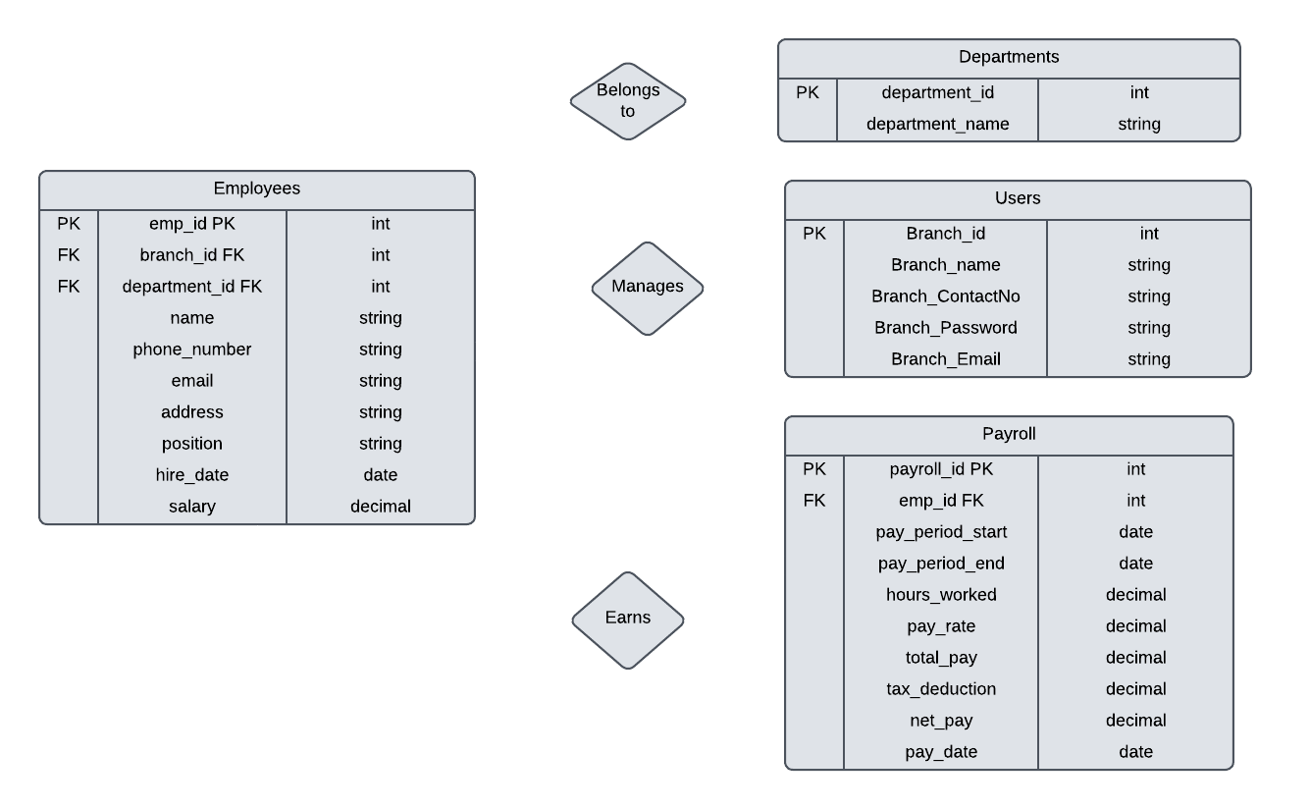
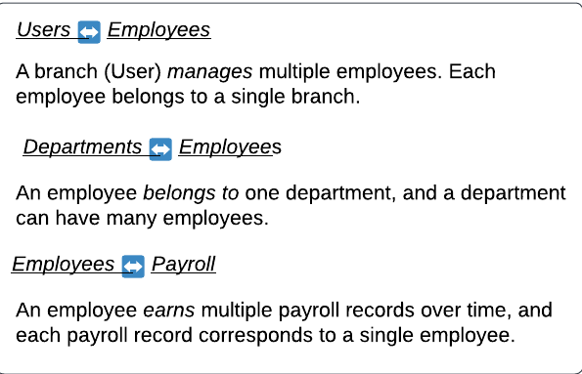
5
ERD:
Slide |
6
7
Project Goals:
Automate payroll processing for employees to ensure fast, accurate, and reliable payroll calculations.
Ensure tax compliance by automatically calculating tax deductions based on regulations.
Provide an easy-to-use web interface for managing employee data and payroll generation.
Solution Overview:
The automation of payroll processes can ensure accuracy, provide timely compensation, maintain tax compliance, and secure data.
Analysis of Limitation:
Traditional payroll methods are prone to human error, such as mistakes in tax calculations or incorrect employee records.
These methods are not scalable - as businesses grow, managing payroll manually becomes more difficult.
Tax deductions and employee records can easily be mismanaged, leading to compliance issues.
Need for Innovation:
The automation of payroll processes can ensure accuracy, provide timely compensation, maintain tax compliance, and secure data.

Slide 7






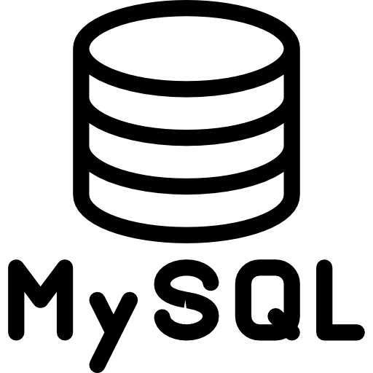






6
Project Demo:
Slide |
7
8
ERD:
Technology Stacks:
Project Goals:
Automate payroll processing for employees to ensure fast, accurate, and reliable payroll calculations.
Ensure tax compliance by automatically calculating tax deductions based on regulations.
Provide an easy-to-use web interface for managing employee data and payroll generation.
Libraries:
HTML
CSS
JavaScript
MySQL
Node.js
express
cors
mysql2
express-session
bcrypt
Solution Overview:
The automation of payroll processes can ensure accuracy, provide timely compensation, maintain tax compliance, and secure data.

Slide 8



SQL Queries (from App.js):
7
Slide |
8
9
ERD:
Project Demo:
Technology Stacks:
Libraries:
HTML
CSS
JavaScript
MySQL
Node.js
express
cors
mysql2
express-session
bcrypt

Slide 9
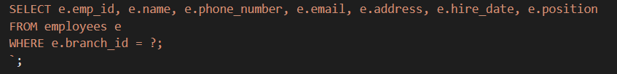
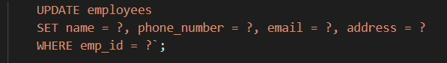
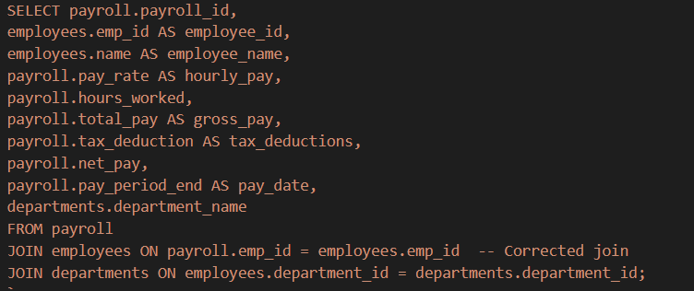
HTML
CSS
JavaScript
MySQL
Node.js
8
Slide |
SQL Queries (from App.js):
9
10
Project Demo:
Technology Stacks:
This query updates an employee’s details in the employee table , whose emp_id match the specific value
query retrieves a list of employees who work in a specific branch
This query inserts a new record into the payroll table , populating the specified columns with the corresponding values provided at runtime.
And many more queries…
Libraries:
express
cors
mysql2
express-session
bcrypt

Slide 10
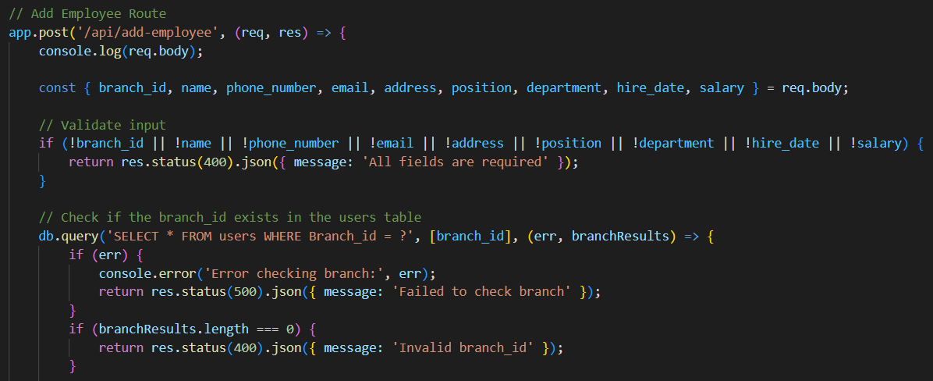
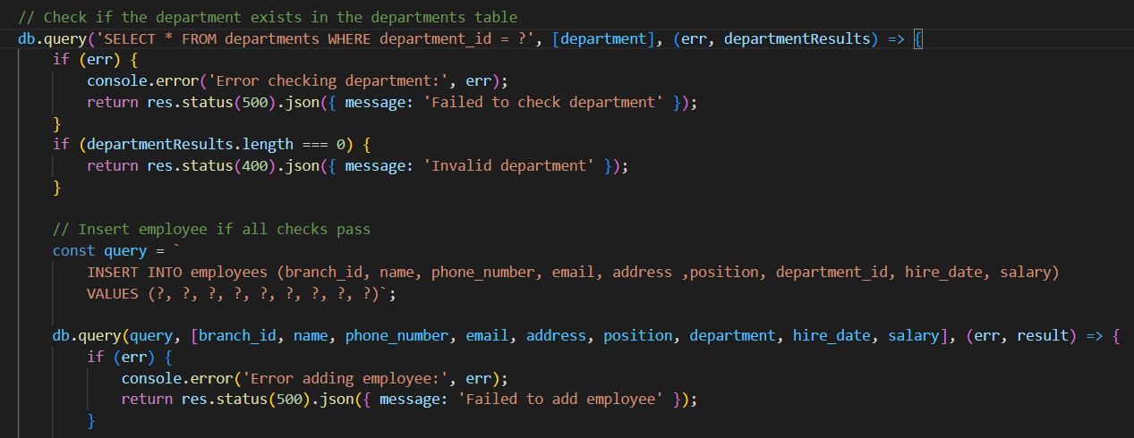
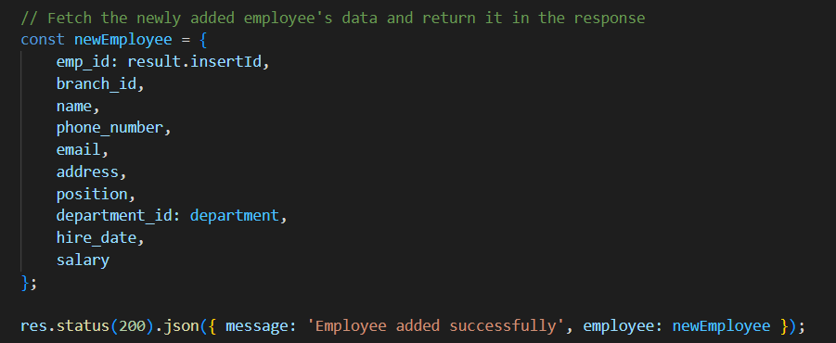
9
SQL Queries (from App.js):
Slide | 1
0
1
DELETE
UPDATE
CRUD
CREATE
FUNCTIONS
READ

Slide 11
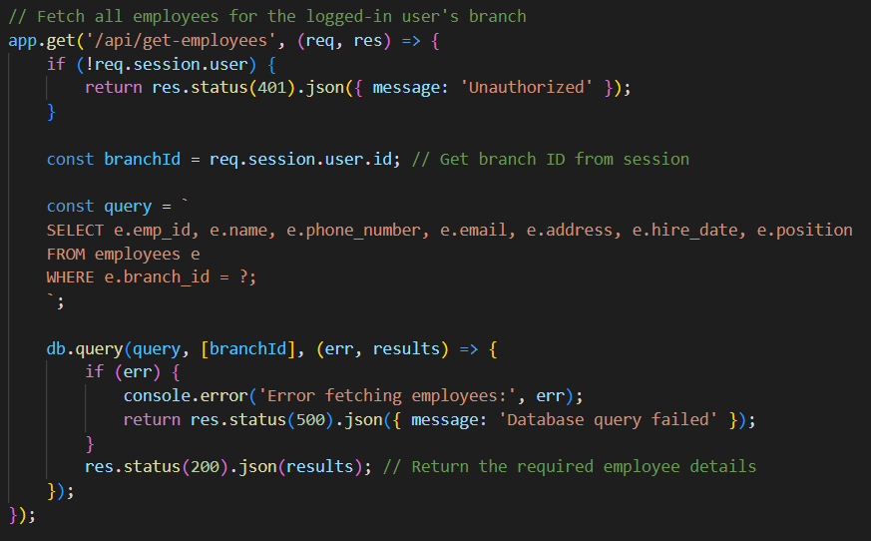
0
Slide | 1
1
2
DELETE
UPDATE
CRUD
CREATE
FUNCTIONS
READ

Slide 12
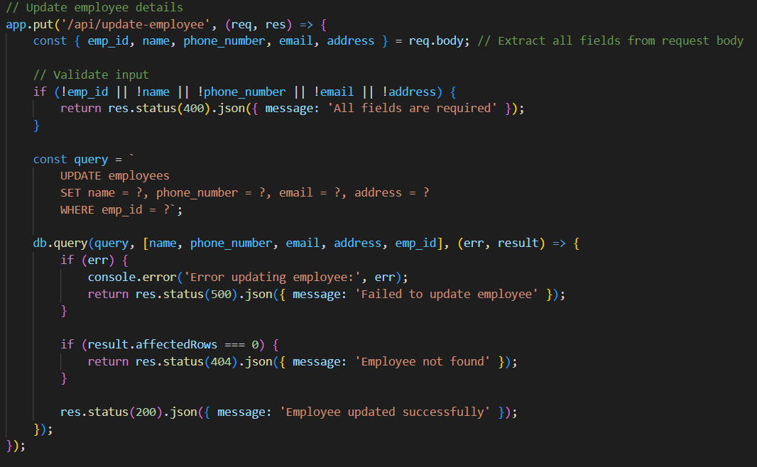
1
Slide | 1
2
3
DELETE
UPDATE
CRUD
CREATE
FUNCTIONS
READ

Slide 13

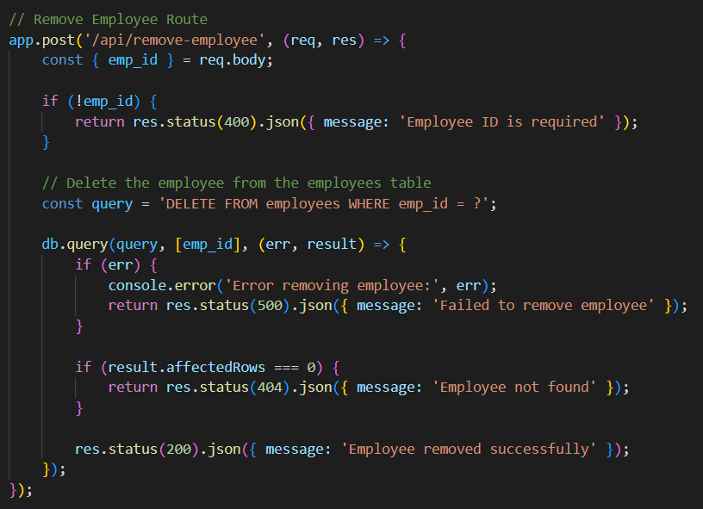
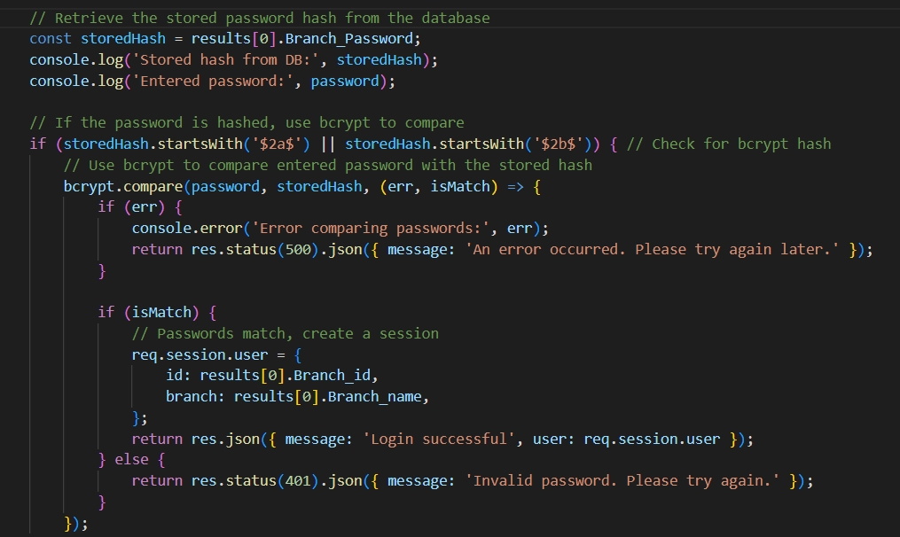

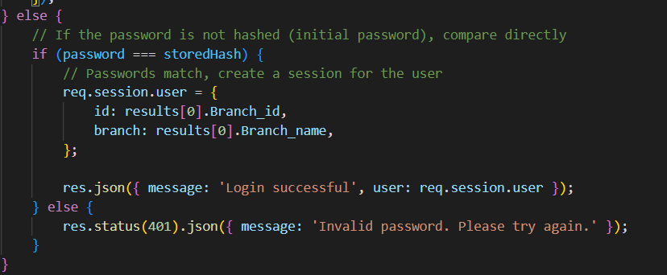
Password Hashing Process: [bcrypt]
2
Slide | 1
3
4
Why Hash ?
DELETE
Enhances security by storing passwords as salted hashes, making them resistant to attacks like rainbow tables.
Ensures even identical passwords have unique hashed values.
UPDATE
CRUD
CREATE
FUNCTIONS
Login Process : Retrieve Hashed Password: The backend fetches the stored hash from the database.
Verify Password: The entered password is compared to the stored hash using bcrypt.
READ
Session Creation: On successful validation, a session is created for the user.

Slide 14

Conclusion & Future Work:
3
Password Hashing Process: [bcrypt]
Slide | 1
4
5
Why Hash ?
Conclusion:
The Payroll Management System streamlines payroll generation by automating calculations and ensuring tax compliance. Features like secure authentication, frontend-backend integration, and dynamic data handling enhance system reliability and usability.
Enhances security by storing passwords as salted hashes, making them resistant to attacks like rainbow tables.
Ensures even identical passwords have unique hashed values.
Future Scope:
Login Process : Retrieve Hashed Password: The backend fetches the stored hash from the database.
Verify Password: The entered password is compared to the stored hash using bcrypt.
Session Creation: On successful validation, a session is created for the user.
Conclusion:
The Payroll Management System streamlines payroll generation by automating calculations and ensuring tax compliance. Features like secure authentication, frontend-backend integration, and dynamic data handling enhance system reliability and usability.
Future Scope:

Slide 15
Password Hashing Process: [bcrypt]
4
Slide | 1
5
6
Conclusion & Future Work:
Why Hash ?
Conclusion:
The Payroll Management System streamlines payroll generation by automating calculations and ensuring tax compliance. Features like secure authentication, frontend-backend integration, and dynamic data handling enhance system reliability and usability.
Enhances security by storing passwords as salted hashes, making them resistant to attacks like rainbow tables.
Ensures even identical passwords have unique hashed values.
Future Scope:
Allow employees to :
- View pay slips and payroll history,
- Update personal details (e.g., contact information, bank account).
- Request and track leave balances (sick leave, vacation, etc.).
- Access tax documents, benefits, and compensation details.
Attendance Tracking:
Enable employees to clock in and clock out using the system.
Automatically track working hours, absences, and overtime.
Integration with Payroll:
Use attendance data to calculate hours worked and determine pay. Account for leave types (e.g., sick days, vacation) in payroll calculations.
Login Process : Retrieve Hashed Password: The backend fetches the stored hash from the database.
Verify Password: The entered password is compared to the stored hash using bcrypt.
Session Creation: On successful validation, a session is created for the user.

Slide 16











Team Roles & Responsibility
Conclusion & Future Work:
Conclusion:
Team Leader
&
Backend Developer
Frontend Developer
&
Tester
Backend Developer
&
Documentation Specialist
Tester
&
Support Developer
The Payroll Management System streamlines payroll generation by automating calculations and ensuring tax compliance. Features like secure authentication, frontend-backend integration, and dynamic data handling enhance system reliability and usability.
Future Scope:
Priyansh
Vijay
Kush
Sahil
01
02
03
04
Equal % for All Team Members [25%]
Conclusion:
The Payroll Management System streamlines payroll generation by automating calculations and ensuring tax compliance. Features like secure authentication, frontend-backend integration, and dynamic data handling enhance system reliability and usability.
Future Scope:

Slide 17

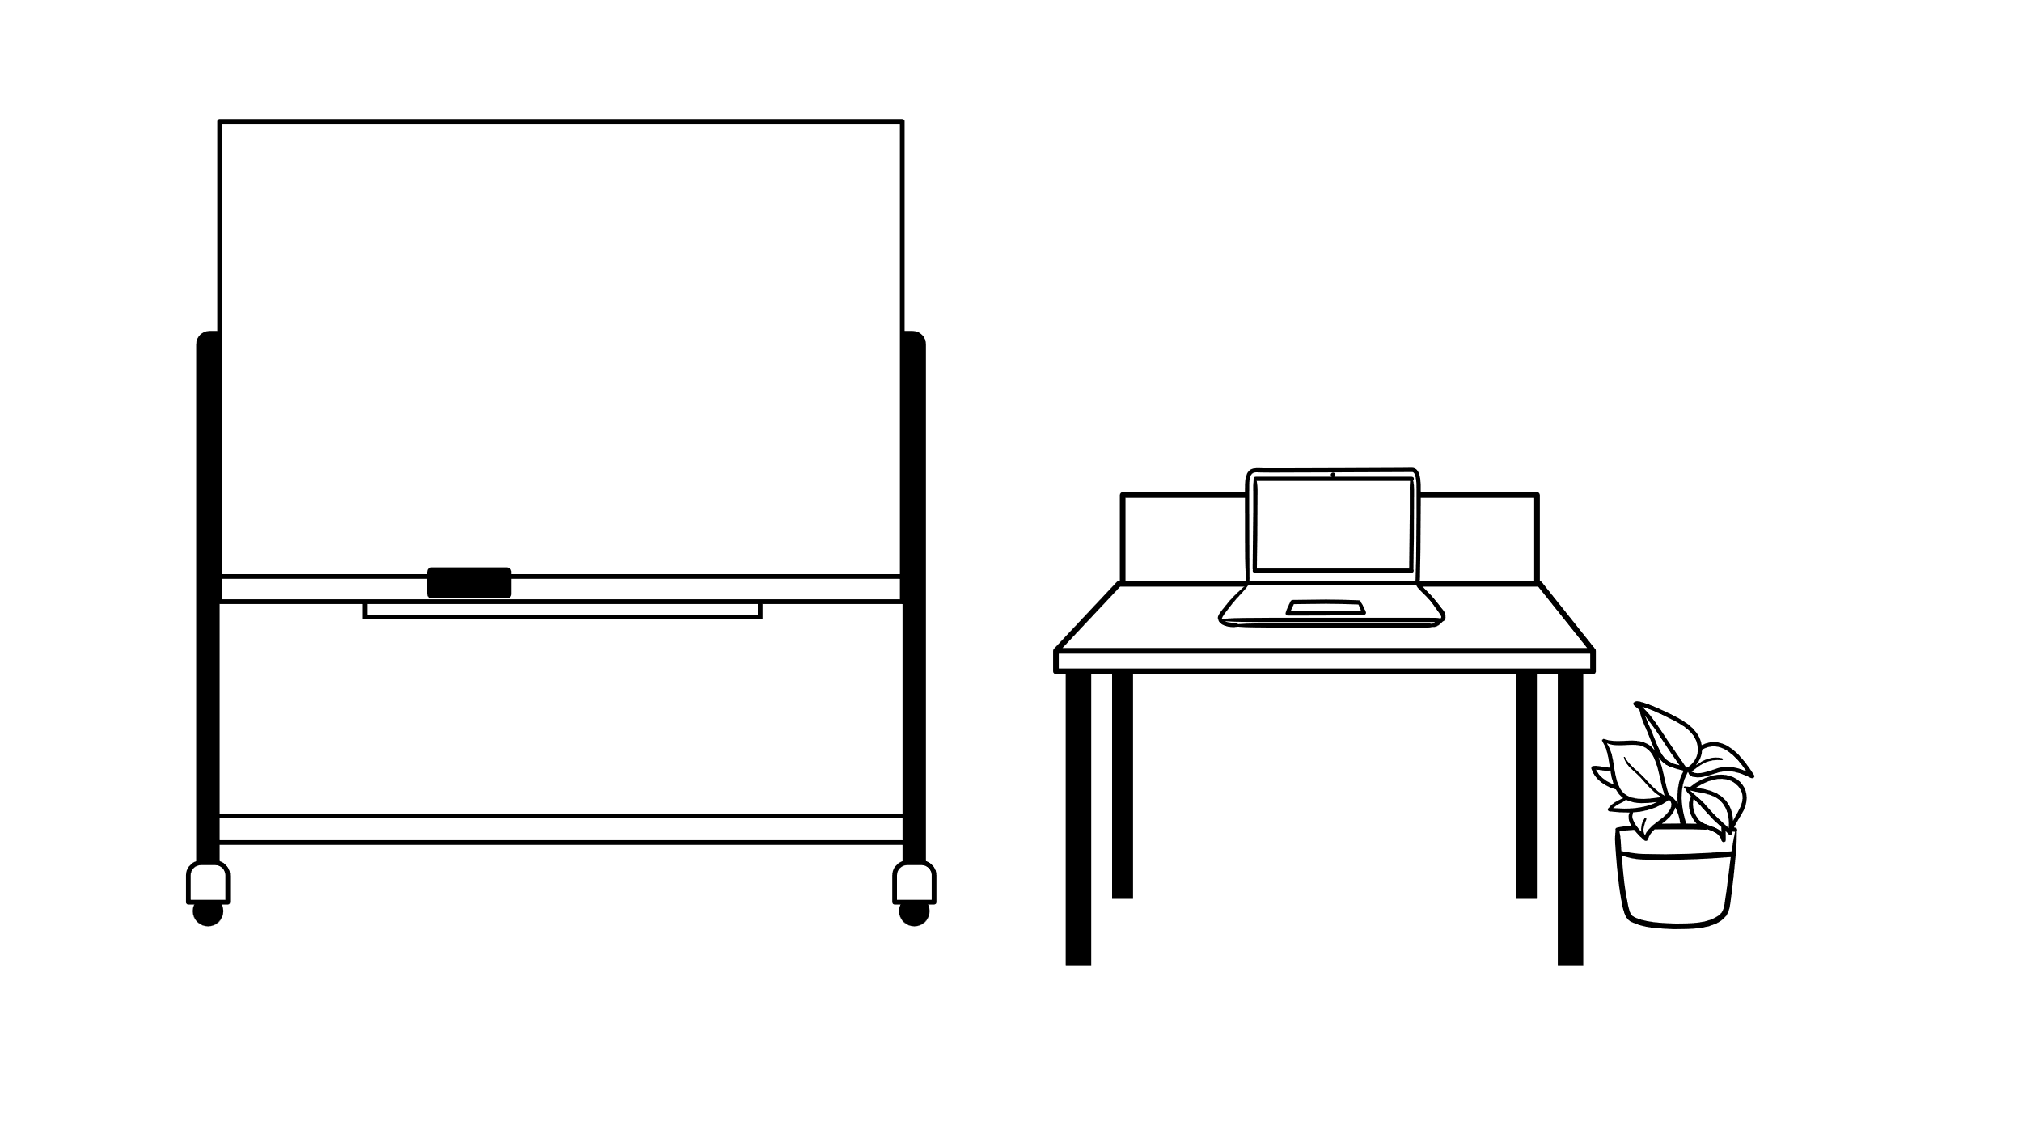




Feel Free To ask Questions
Thank
You !!

